Slide 1


SDL MINI PROJECT
TITLE
OLD BOOKS ONLINE SELLING
GROUP MEMBERS : GUIDED BY:
Tanvi Joshi – T150134263 Mr.K.P.Birla
Vedika Mujgule - T150134287 Mr .W.W.Pingle
Spandan Patel – T150134301
Rashmi Purandare – T150134310

Slide 2
OBJECTIVES
The purpose of this project is to provide easy online buying and selling of old books.
Other objective is to provide university question papers.
The proposed system will offer a web-based interface for students.

Slide 3
PROBLEM DEFINATION
To create a web interface which allows students to shop old books and reuse them.
Provide the facility for students/staff to download university question papers from the website.

Slide 4
TARGET USERS
Students.
Professors.

Slide 5
TECHNOLOGY
JSP- JAVA SERVER PAGES
Java Server Pages (JSP) is a technology that helps software developers create dynamically generated web pages based on HTML
To run Java Server Pages, a compatible web server such as Tomcat or Glassfish, is required.

Slide 6
REQUIREMENTS
Software Requirements:
JDK – Java Development Kit
Netbeans IDE – 8.2
MySql for database
Glassfish server
Hardware Requirements:
Laptop

Slide 7
SCOPE
The following is the scope that our web interface provides :
Easy assistance to both the buyer as well as the seller with proper database and information.
Provides scope for downloading university question papers.
Provides scope for buying books related to university syllabus.

Slide 8
Use case diagram
REGISTER
LOGIN
BOOK SHOP
SELL
FILL DETAILS
STUDENT
BOOK ADDED
LOGOUT

Slide 9
Graphical User Interface (GUI)
Login or Sign Up Page.
Login Page.
Header.
Question Paper Download Page.
Contact Us Page.
Buy or Sell Redirect Page.
Seller Page.
Buyer Page.
Chat Room Page.

Slide 10

Sign In or Sign Up

Slide 11
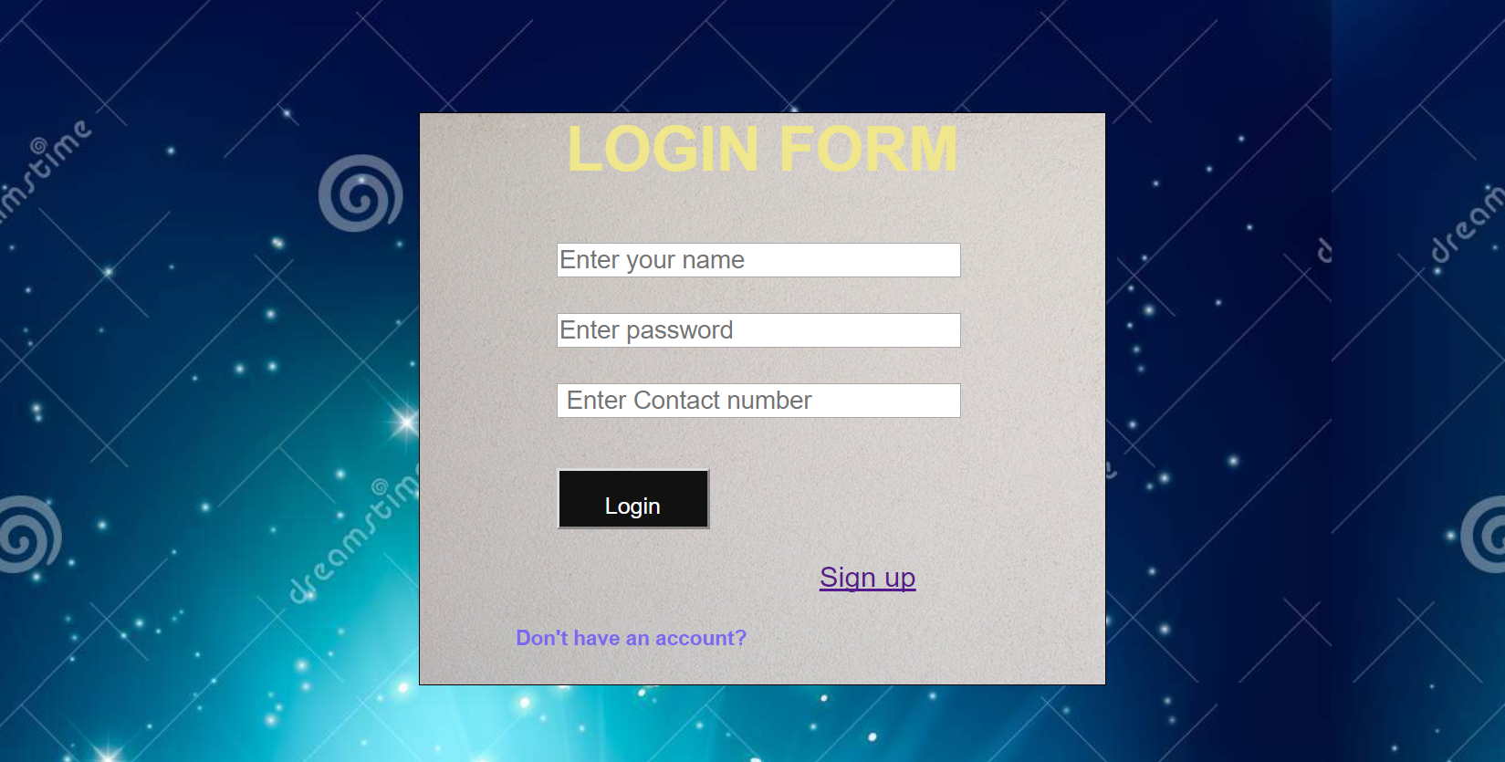
Login Page

Slide 12
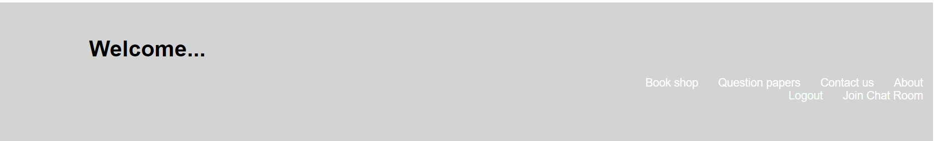
Header

Slide 13
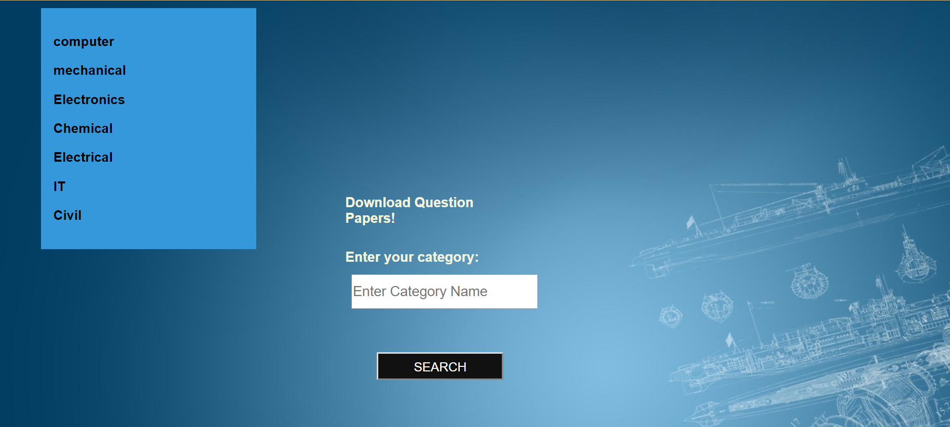
Question Paper Download

Slide 14
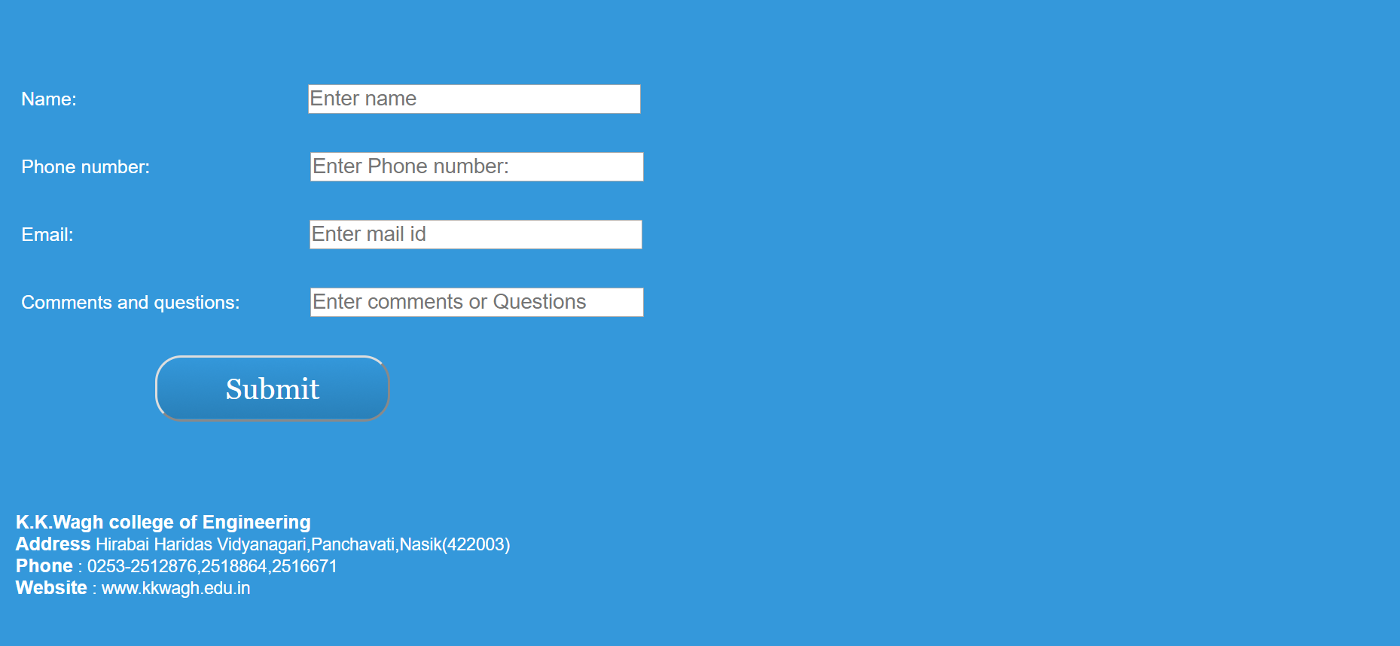
Contact Us

Slide 15
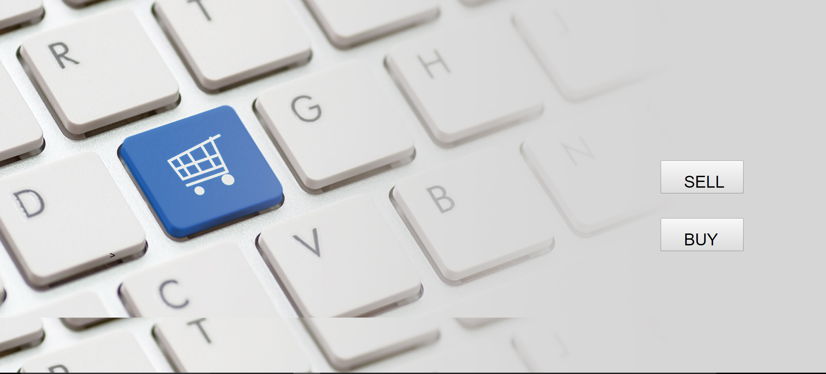
Buy or Sell

Slide 16
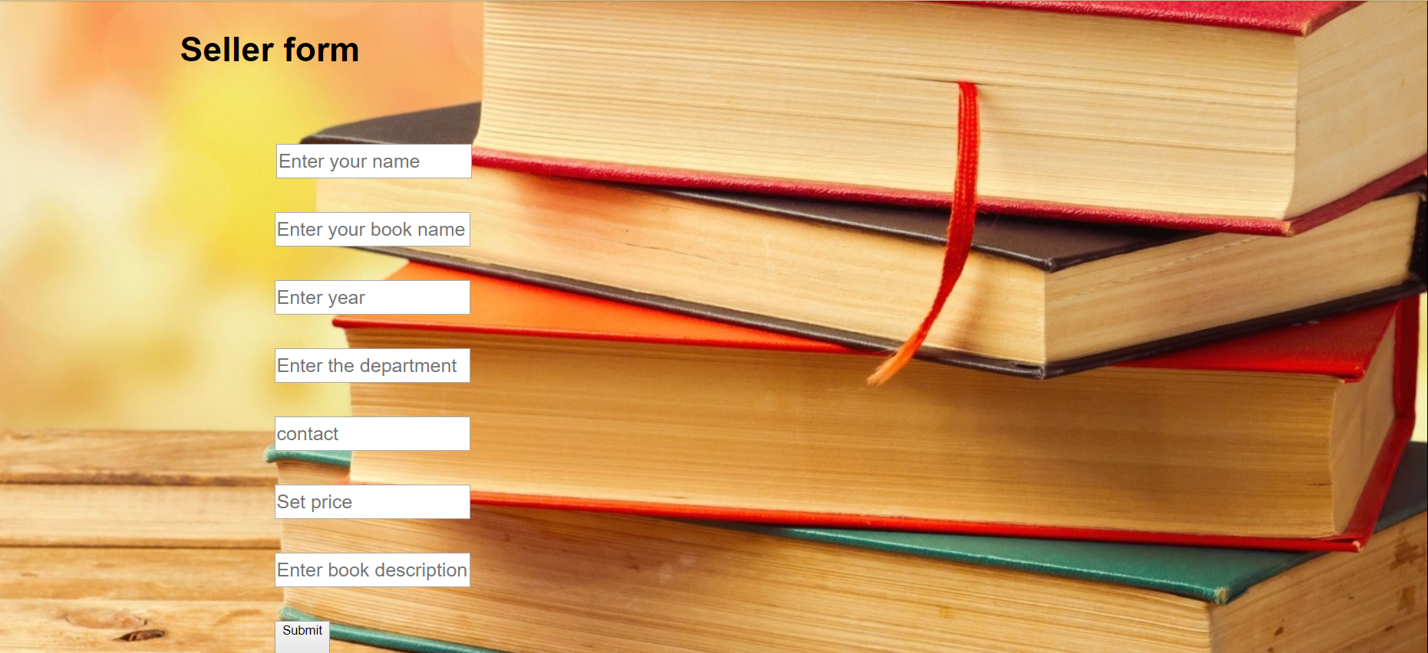
Seller Page

Slide 17
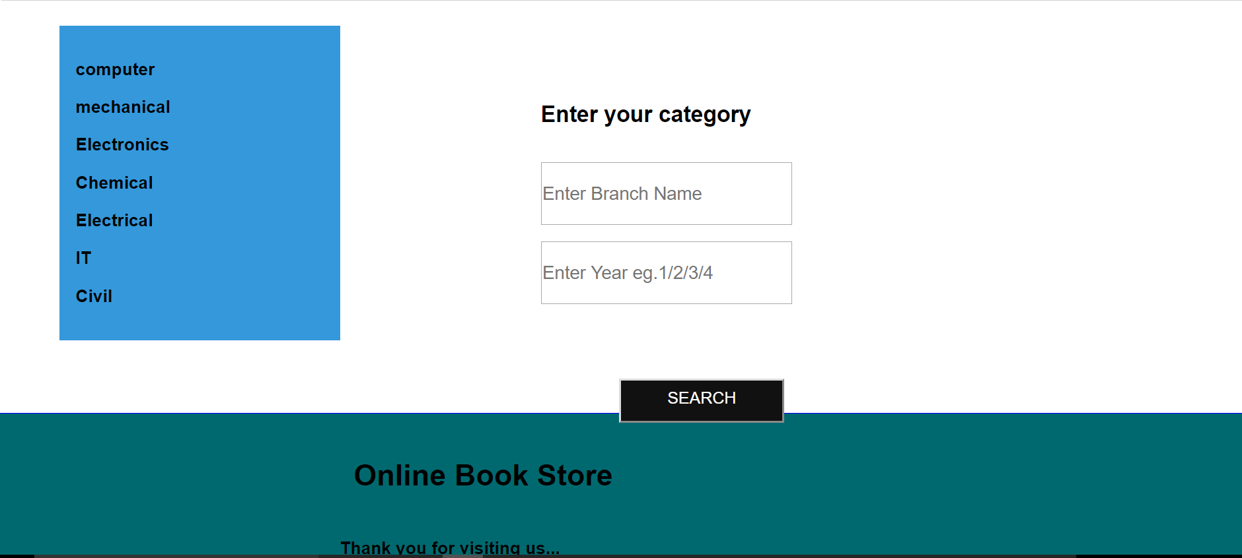
Buyer Page

Slide 18
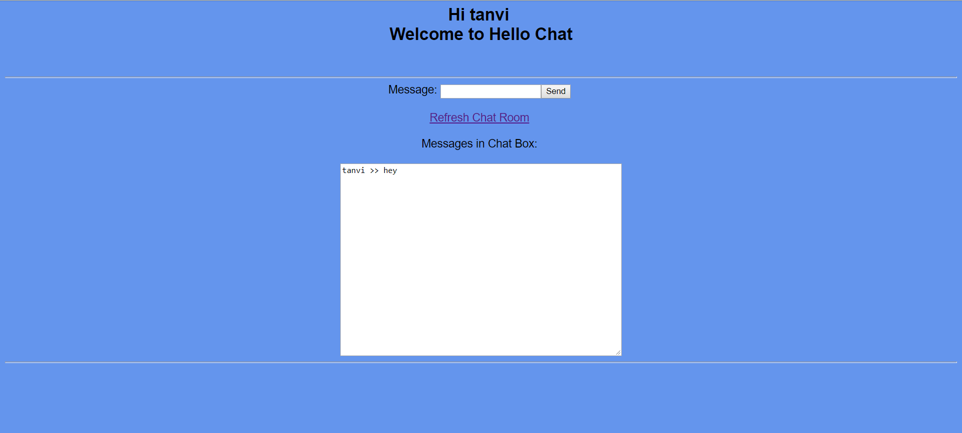
Chat Room

Slide 19
FEATURES
Customer SignIn and SignUp.
Buy books by year and department.
Download university question papers.
Chat Room feature provided.
Contact Us feature provided.

Slide 20
LIMITATIONS
Book sold no updation available.
Monetary transaction .
Contact Us .
Privacy for chat room.

Slide 21
PERFORMANCE MEASURES
Type | Description | Example
Quantitative | Quantity of output expected | Make max number of books available for shopping
Qualitative | Specific quality of output expected | Meet university quality standards
Time | Time by which result should be achieved | Completed within 40-45 days End date:10-10-2017
Cost | Cost or price considered appropriate or acceptable to achieve the end results | All open source software used

Slide 22
CONCLUSION
The web-application is system which provides the facility to the students to purchase the books from our web interface without any complexity.

Slide 23
THANK YOU !
GROUP MEMBERS :
Tanvi Joshi – T150134263
Vedika Mujgule - T150134287
Spandan Patel – T150134301
Rashmi Purandare – T150134310

